Slide 1


Solution Development in Visual Studio Code

Slide 2



Introductions
Peik Bech-Andersen
Lead MCT Microsoft Dynamics NAV 2013, Microsoft Readiness Program
MCT, MCITP, MBMSP, MCTS
Dynamics NAV 2013 Development
Dynamics NAV 2013 Installation & Configuration
Dynamics NAV 2013 Core Setup & Finance
Dynamics NAV 2009 Application
Dynamics NAV 2009 Development
Dynamics NAV 2009 Installation & Configuration
SQL Server 2005
Managing Microsoft Dynamics Implementations
SharePoint Administrator
EC-Councill
Certified Ethical Hacker

Slide 3
Introduction to Visual Studio Code
The Visual Studio Code Editor
Native Github integration
Using Snippets
Creating Snippets
Converting existing objects to AL
And of course, creating objects:
New Tables
Extending existing tables, including which properties can be changed and where to add code to triggers
New Pages
Extending existing pages, including which properties can be changed and where to add code to triggers
Creating codeunits, including:
Event subscriptions
Install Codeunits
Upgrade Codeunits
Creating reports in Dynamics 365 Business Central
Creating reports in Dynamics NAV 2018
Creating XML Ports
Creating Queries
Controlling the Departments menu
Design patterns in Dynamics NAV/Dynamics 365 BC
Using the Visual Studio Code editor with other extensions, like:
PowerShell
XML Documents
JSON Tools
Snippet Creator
Upgrading to extensions
Differences between solution development in Dynamics NAV 2018 and Dynamics 365 BC

Slide 4
Agenda
Solution Overview
Introduction to the Visual Studio Code editor
Setting up a Git repository
Data and Process Model
Master Tables and Pages
Documents
Posting
Feature Integration
Reporting
Role Tailoring

Slide 5
Introduction to the Visual Studio Code editor
The Visual Studio Code editor (VS Code) is a lightweight but powerful open-source editor. It runs on your desktop and is available for Windows, macOS and Linux. It comes with built-in support for JavaScript, TypeScript and Node.js and has a rich ecosystem of extensions for other languages (such as C++, C#, Java, Python, PHP, Go) and runtimes (such as .NET and Unity).
Now Microsoft have released an extension for VS Code so that it supports the AL language, that is necessary to create extensions for Dynamics 365 “BC”.

Slide 6
Extensions
Extensions are a programming model where functionality is defined as an addition to existing objects and defines how they are different or modify the behavior of the solution. This section explains how you can develop extensions using the development environment for Dynamics 365 “BC”.

Slide 7
Start project
AL:Go!

Slide 8
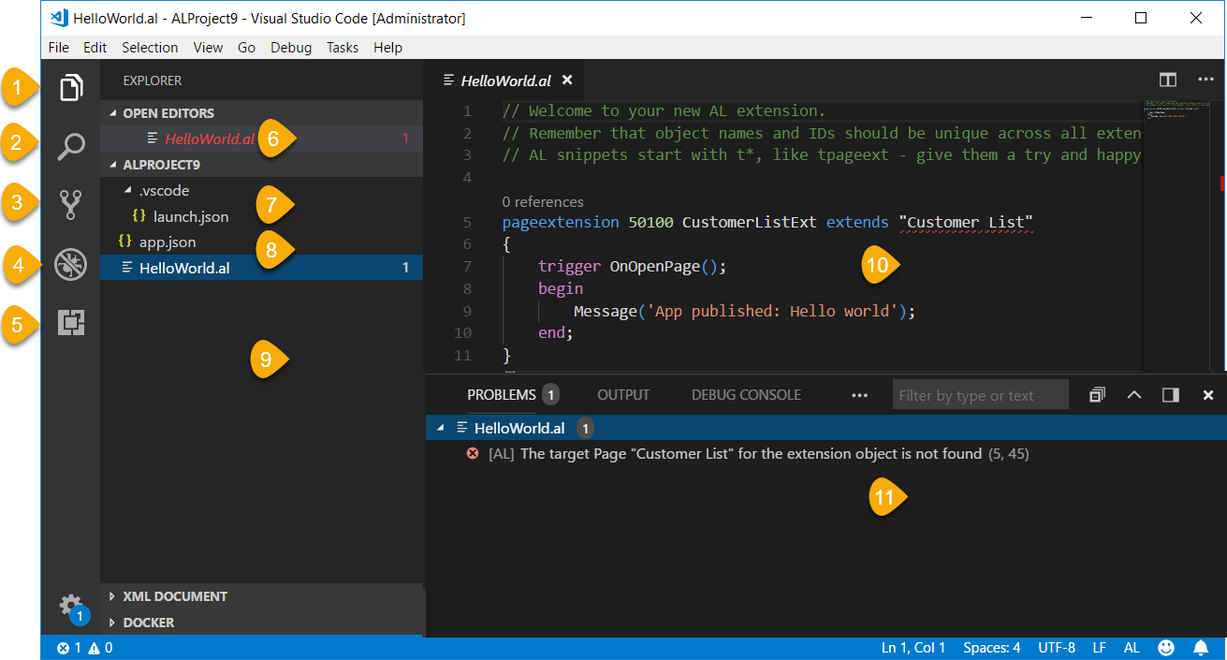
The Editor
Explorer
Search
Source Control
Debug
Extensions
Open Editors
launch.json
App.json
Workspace
Editor window
Problem / Output / Debug / Terminal

Slide 9
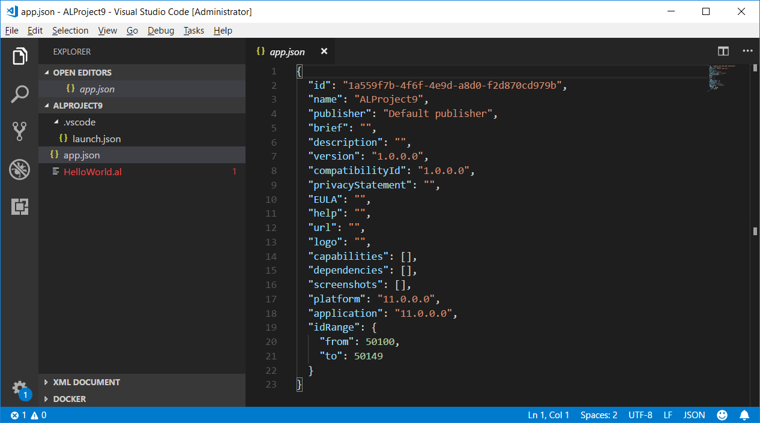
App.json
Manifest file
Id
Name
Publisher
Build parameters
Dependencies
Versioning
Object Numbers
p37

Slide 10
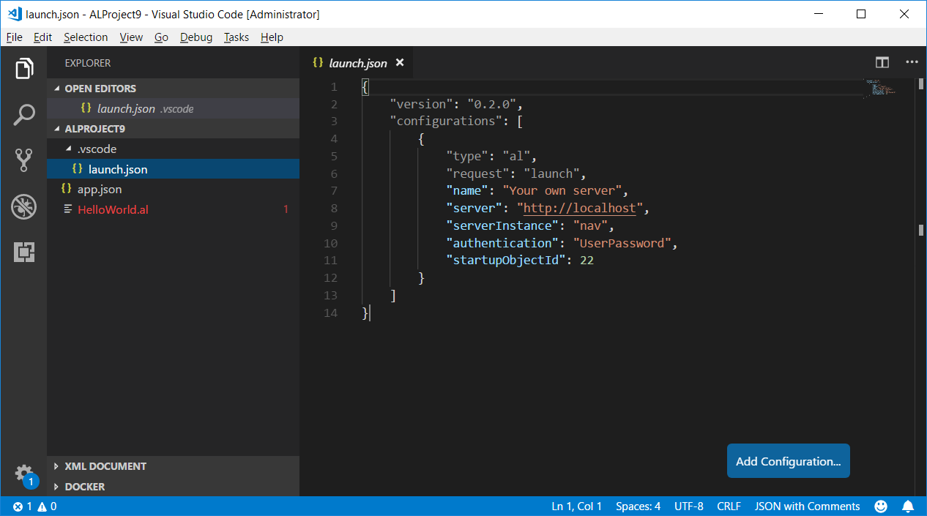
Launch.json
Connection
Name
Server
Instance
Authentication
Startup ID
Schema Sync.
p40

Slide 11
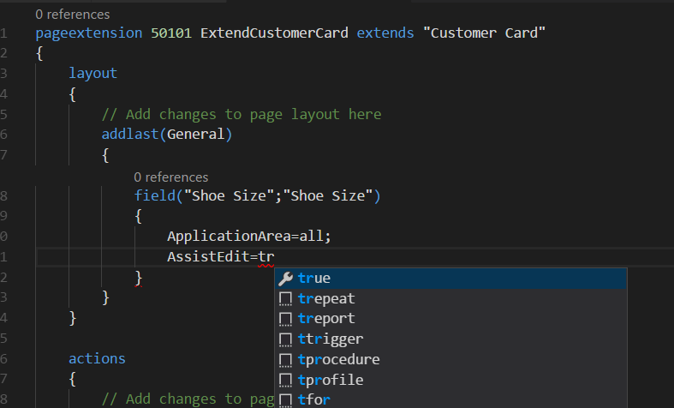
Intellisense
Start typing
If Intellisense does not work, there is an error above!

Slide 12
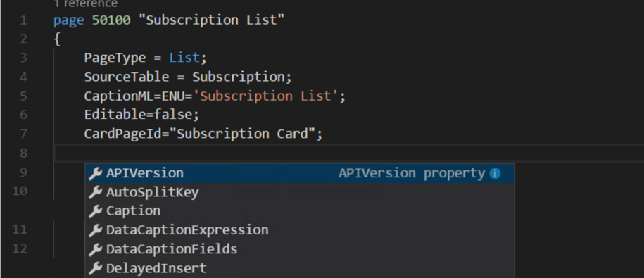
Property list
Ctrl+[Space]

Slide 13
Snippets
Objects |  | Description
 | ttable | Create new table
 | ttableext | Create extension for an existing table
 | tpage | Create new page
 | tpageext | Create extension for an existing page
 | treport | Create new report
 | txmlport | Create new XMLport
 | tquery | Create new query
 | tcodeunit | Create new codeunit
In objects
 | ttrigger | Create example of a new trigger
 | tprocedure | Create example of a new procedure (function)
 | taction | Create example of a new action
In tables
 | tfield | Create example of a new field
 | tfieldcode | Create example of a new field of type code, length in [20]
 | tfielddate | Create example of a new field of type date
 | tfielddecimal | Create example of a new field of type decimal
Objects | Description
Events
 | teventbus | Create example of a new business event
 | teventint | Create example of a new integration event
 | teventsub | Create example of a new event subscription
Repetitive commands
 | tfor | Create example of a for - to loop
 | tforeach | Create example of a foreach loop
 | twhile | Create example of a while loop
 | trepeat | Create example of a repeat - until loop
Statements
 | tif | Create example of an if - then statement
 | tcaseelse | Create example of an if - then - else statement
 | tcaseof | Create example of an case statement

Slide 14
Differences in the Development Environments
Data types
Syntax updates
C/SIDE | AL Language Development Environment
Dates are parsed based on culture settings. | Locale independent and supports only: yyyy-mm-ddD.
Boolean values could be expressed as yes/no. | Boolean values are expressed as true/false.
C/SIDE | AL Language Development Environment
The token for multilanguage comment is @@@. | A multilanguage comment is marked with Comment.
Supports TryFunction on code developed in C/SIDE. | Supports calling referenced TryFunctions from W1.
Reserved commands are always uppercase | Reserved commands stays in the same as it was entered
For tables, integers could allow decimal values. For example, 5.0 converts to an integer, 5.4 throws an error at runtime. | For tables, Min, Max, InitValue numbers with a fraction are expressed as decimal, thus they are not a valid integer data type.
The largest constant integer could be 999999999999999. | Transforms to 999'999'999'999'999.0, a decimal value. In AL, this can be expressed as 999999999999999.0 or 999999999999999L.

Slide 15
Differences in the Development Environments
Several properties have been renamed, to mention some:
Pages
C/SIDE | AL Language Development Environment
AutoFormatExpr | AutoFormatExpression
DataCaptionExpr | DataCaptionExpression
Layout | GridLayout
ProviderID | Provider
C/SIDE | AL Language Development Environment
ActionItems |  | Processing
ActivityButtons |  | Sections
HomeItems |  | Embedding
NewDocumentItems |  | Creation
RelatedInformation |  | Navigation
Reports |  | Reporting

Slide 16
Differences in the Development Environments
Discontinued functionality
All variables of the type DotNet is not allowed in new development environment.

Slide 17
C/Side and AL Side-by-side development
Dynamics NAV 2018 supports development using both C/SIDE and AL, as well as Designer side-by-side. When new objects are added or changed in C/SIDE these changes must be reflected in the symbol download in Visual Studio Code using the AL Language extension. To enable this reflection, a new command and argument has been added to finsql.exe called generatesymbolreference.

Slide 18
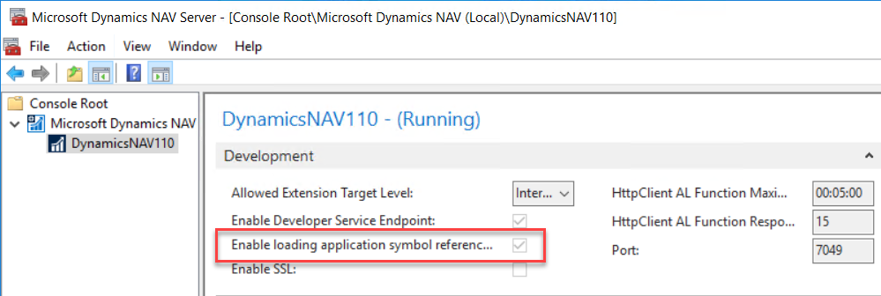
C/Side and AL Side-by-side development

Slide 19
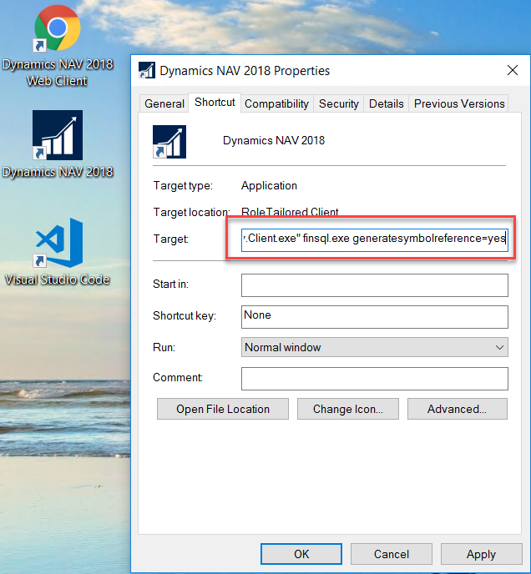
C/Side and AL Side-by-side development

Slide 20
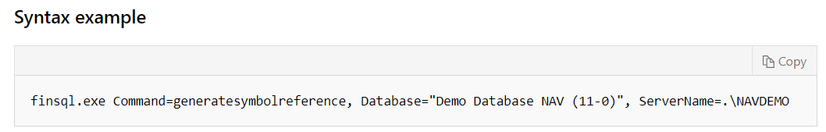
C/Side and AL Side-by-side development
Use the generatesymbolreference command specified with the database and server name. This command will add symbol references to the Object Metadata table for the specified database.
This is a lengthy operation and will block the objects in the database for other modification.
Alternatively, all objects can be compiled after opening the Development Environment with the generatesymbolreference=yes parameter

Slide 21
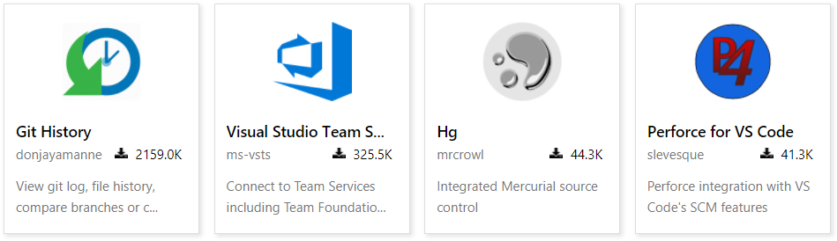
Version Control in VS Code

Slide 22

Git support
Git is a version control system for tracking changes in computer files and coordinating work on those files among multiple people. It is primarily used for source code management in software development, but it can be used to keep track of changes in any set of files. As a distributed revision control system, it is aimed at speed, data integrity, and support for distributed, non-linear workflows.

Slide 23
Git support
Installing Git
Creating a new repository
Cloning an existing repository
Other Git functionalities

Slide 24
Extensions and events
Tables
Pages
Codeunits
Reports
Queries
XMLports
As well as this, it is possible to extend some existing objects:
Table extensions
Page extensions

Slide 25
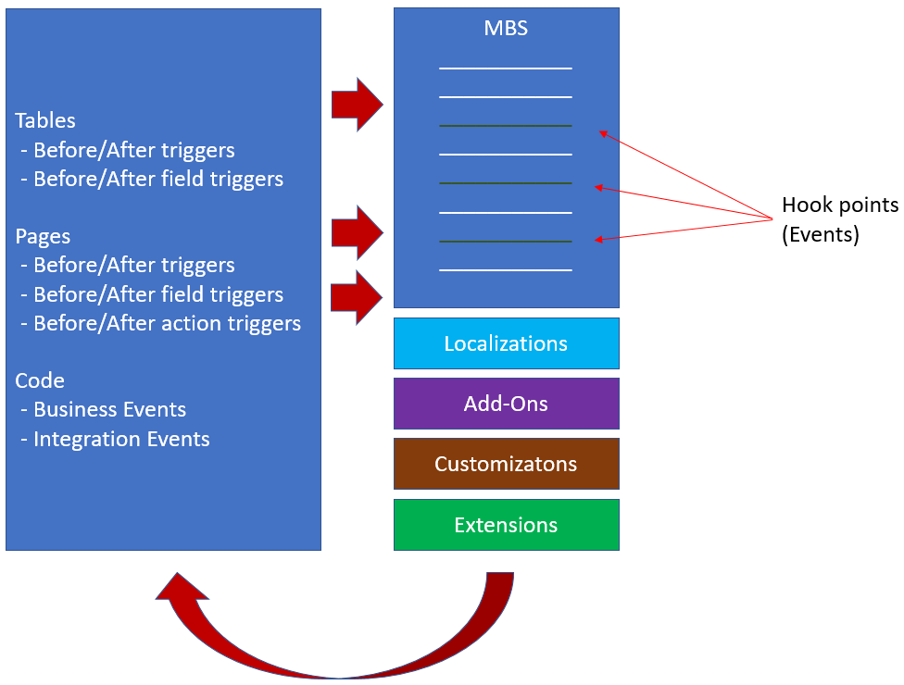
Extensions and events

Slide 26
Extensions and events
Table Extensions
Table properties
As a main rule, it is not possible to change table properties in a table extension. However, there are a number of exceptions:
Caption
DataCaptionFields
Description
Table Triggers
It is not possible to change to delete code in existing triggers. The available triggers are:
OnBeforeInsert
OnAfterInsert
OnBeforeModify
OnAfterModify
OnBeforeDelete
OnAfterDelete
OnBeforeRename
OnAfterRename

Slide 27
Extensions and events
Table Extensions
Fields
Existing tables can be extended with new fields. Also here, It is recommended that the field number is placed in a remote area of the 50.000-99.999 area or even better, that an add-on number series Is used, to avoid conflicts with other extensions.
Field Properties
Field properties can be added without limitations on new fields. The properties on existing fields that can be changes are:
Caption
DataCaptionFields
Description
CaptionClass
OptionCaption
ClosingDates
Width

Slide 28
Extensions and events
Table Extensions
Field Triggers
It is not possible to add code to the existing triggers on a field, but it is possible to add code to triggers before and after the OnValidate trigger:
OnBeforeValidate
OnAfterValidate
On new fields, it is possible to add code to the usual triggers:
OnValidate
OnLookup

Slide 29
Extensions and events
Page Extensions
Page properties
As a main rule, it is not possible to change page properties in a page extension. However, there are a number of exceptions:
Caption
Description
InstructionalText
DataCaptionExpression
PromotedActionCategories
Page Triggers
It is not possible to change to delete code in existing triggers. However, it is possible to add code in separate triggers that will be executed after the existing trigger. The available triggers are:
OnAfterGetCurrRecord
OnAfterGetRecord
OnClosePage
OnDeleteRecord
OnInsertRecord
OnModifyRecord
OnNewRecord
OnOpenPage
OnQueryClosePage

Slide 30
Extensions and events
Page Extensions
Field Triggers
It is possible to add code to the existing triggers on a field:
OnBeforeValidate
OnAfterValidate
On new fields, it is possible to add code to the usual triggers:
OnValidate
OnLookup
Page field group
Visible
Enabled
InstructionalText
FreezeColumn
Page part
Visible
Enabled
ToolTip

Slide 31
Extensions and events
Page Extensions
Page action group
Caption
Description
ToolTip
Visible
Enabled
Page action triggers
Page action triggers cannot be changed or extended. Instead, an Eventsubscription must be made.
Page action
Caption
Description
ToolTip
Visible
Enabled
ApplicationArea
Promoted
PromotedIsBig
PromotedOnly
PromotedCategory
ShortcutKey
InFooterBar

Slide 32
Events in Dynamics NAV & 365 BC
 | NAV2016 | NAV2017 | NAV2018 | DYN365BC
Business |  |  | 1 | 1
Integration | 128 | 232 | 1236 | 1778
Grand Total | 128 | 232 | 1237 | 1779
 | NAV2016 | NAV2017 | NAV2018 | DYN365BC
Codeunit | 106 | 159 | 799 | 1178
Page |  | 13 | 50 | 111
Query |  | 1 | 1 | 1
Report | 1 | 1 | 26 | 39
Table | 21 | 58 | 361 | 450
Grand Total | 128 | 232 | 1237 | 1779

Slide 33
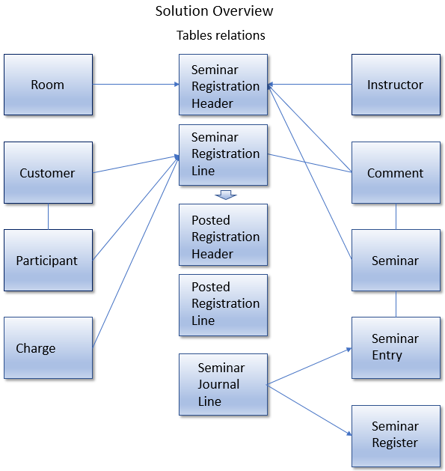
Solution Overview

Slide 34
Table types
Type | Remarks | Examples
Master | Table that contains information about the primary focus subject of an application area. | Customer, Vendor, Item
Supplemental | Table that contains information about a supplemental subject that is used in one or more application areas. | Language, Currency
Setup | Table that contains one record that holds general information about a application area. | General Ledger Setup, Sales & Receivables Setup
Register | Table that acts as a table of contents for its corresponding ledger table or tables. | G/L Register, Item Register
Type | Remarks | Examples
Subsidiary | Table that contains additional information about a master table or a supplemental table. | Item Vendor, FA Depreciation Book
Ledger | Table that contains the posted transactional information that is the primary focus of its application area. | Cust. Ledger Entry, Item Ledger Entry
Journal | Primary table that allows you to enter transactions for an application area. | Purchase Journal, Item Journal

Slide 35
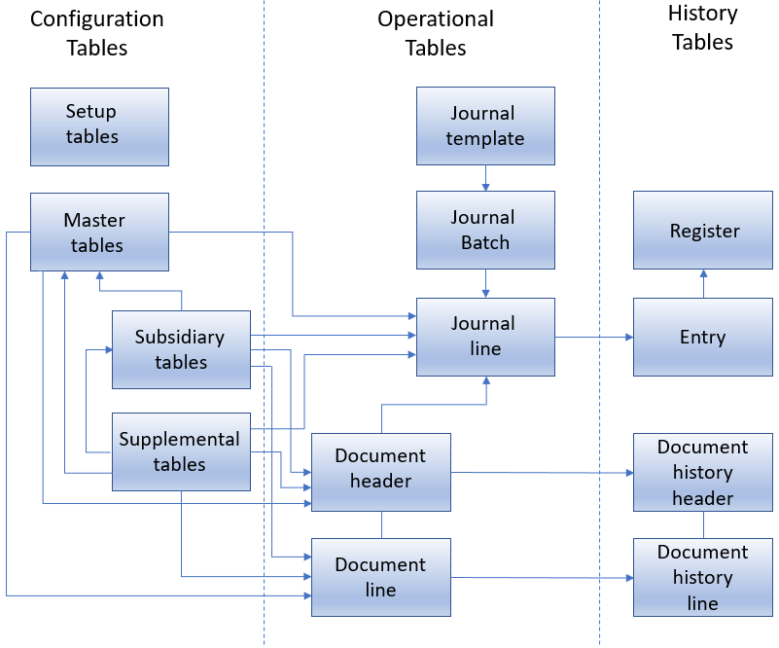
Data Model Diagram

Slide 36
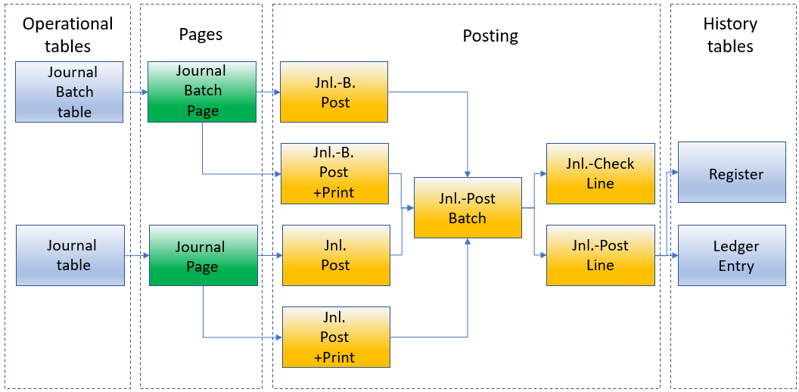
Journal Posting

Slide 37
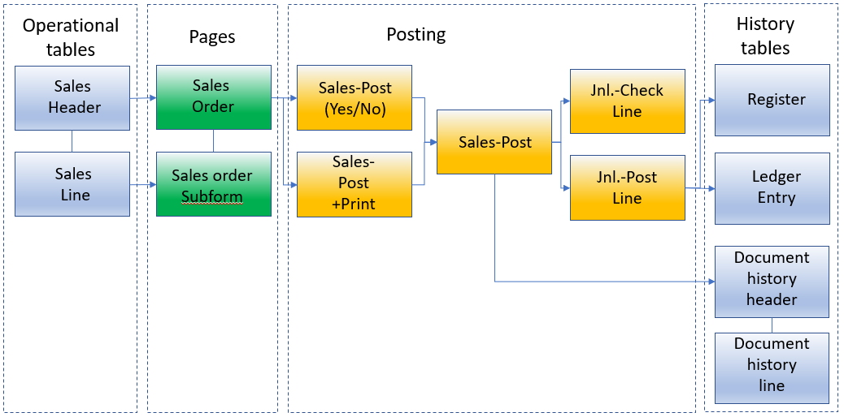
Document Posting

Slide 38
FilterGroup
Number | Name | Description
-1 | Cross-column | Used to support the cross-column search.
0 | Std | The default group where filters are placed when no other group has been selected explicitly. This group is used for filters that can be set from the filter dialogs by the end user.
1 | Global | Used for filters that apply globally to the entire application.
2 | Form | Used for the filtering actions that result from the following: SETTABLEVIEW Function (Page, Report, XMLport) SourceTableView Property DataItemTableView Property.
3 | Exec | Used for the filtering actions that result from the following: SubPageView Property RunPageView Property
Number | Name | Description
3 | Exec | Used for the filtering actions that result from the following: SubPageView Property RunPageView Property
4 | Link | Used for the filtering actions that result from the following: DataItemLink Property (Reports) SubPageLink Property
5 | Temp | Not currently used.
6 | Security | Used for applying security filters for user permissions.
7 | Factboxes | Used for clearing the state of factboxes.

Slide 39
Object Numbering
Object Number Series | Origin
0 - 49.999 | The standard solution from Microsoft
10.000 - 19.999 | Country specific localization from Microsoft
50.000 – 99.999 | Object range to be used by all Microsoft partners for customizations. End-user customers has to acquire access to any range used by the Microsoft partner.
50.000 – 50.009 | Included in the starter pack: Access to ten tables and codeunits.
50.010 – 50.019 | Included in the extended pack: Access to ten tables and codeunits.
50.000 – 50.099 | Also included in the starter pack: one hundred pages, reports, Queries and XMLports.
50.100 – 50.199 | Also included in the extended pack: one hundred pages and XMLports.
100.000 – 999.999 | Testing objects and other objects reserved by Microsoft
1.000.000 – 98.999.999 | CfMD approved add-ons
99.000.000 – 99.999.999 | Microsoft Standard functionality for the manufacturing module
1.000.000.000 | Used by Dynamics NAV versions up till NAV 2009 for storing data on restoring a backup to the system. When the restore is completed all objects and data are moved from the 1.000.000.000 range to the actual ranges.
2.000.000.000 | System and virtual objects
123.465.700 – 123.456.799 | Objects used only for training purposes

Slide 40
The InDataSet property
Due to the Dynamics 365 BC architecture, all code is executed in the service tier. This also means that variables are not available in the page by default. In order to make the variable available on the page, it is necessary to include the variable to the dataset. This is done by setting a property just before assigning the variable:
var
[InDataSet]
ShowType : Boolean;
[InDataSet]
ShowMaxField : Boolean;

Slide 41
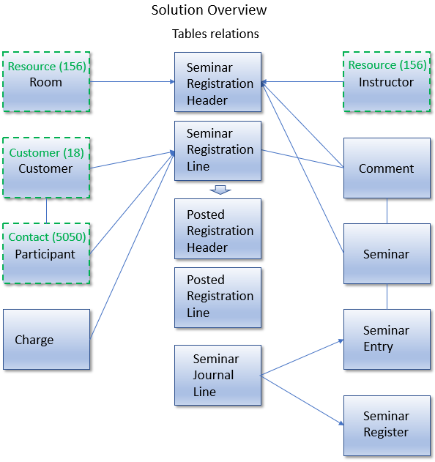
Solution Overview

Slide 42
Field names in Extensions
You must use a prefix/suffix when naming all new objects. When you modify a core Dynamics 365 object using a Table Extension or Page Extension, the prefix must be defined at the control or field level.
The prefix only applies to the name, the caption will be as normal to keep semblance to the users. E.g. name: “CSD Resource Type” and caption ‘Resource type’
The same applies to these controls on pageextensions
Action Group names
Action names
Group names
CueGroup names

Slide 43
Object naming in Extensions
You must use a prefix/suffix when naming all new objects. When you modify a core Dynamics 365 object using a Table Extension or Page Extension, the prefix must be defined at the control or field level.
table 70000000 CSD Salesperson
page 70000000 CSD Salesperson Card
codeunit 70000000 CSD Salesperson Management

Slide 44
Reserve your own prefix
d365val@microsoft.com

Slide 45
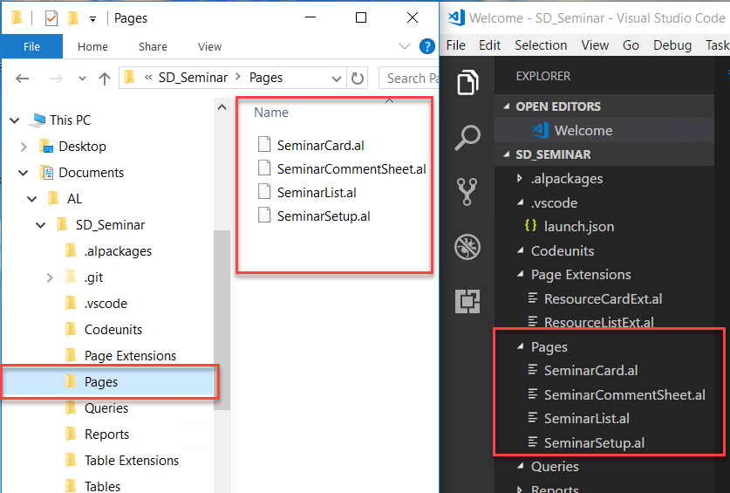
Import and export of files to and from the workspace.

Slide 46
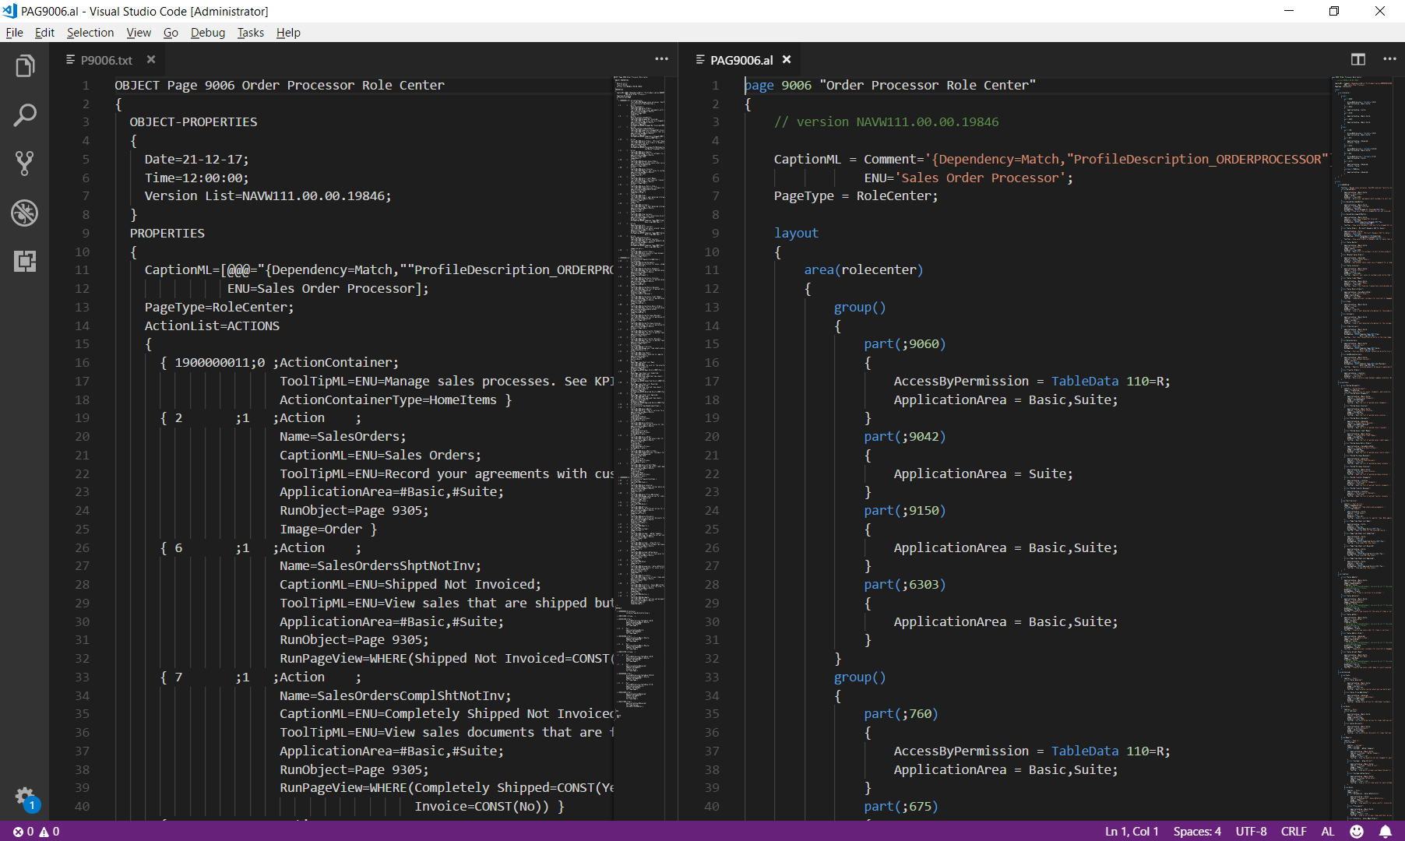
Txt2Al conversion

Slide 47
Multilanguage Functionality in Extensions
In previous versions of Dynamics NAV, it was necessary to maintain all languages directly in the Development Environment. When you created messages for the user, you had to make sure that the text and the object names in the messages were enabled for multilanguage functionality.
Dynamics 365 BC handles multilanguage in a different way. Instead of storing all texts in different languages in the code, the texts are stored in XLIFF files. XLIFF (XML Localization Interchange File Format) is an XML-based format created to standardize the way localizable data are passed between tools during a localization process and a common format for CAT tool files.

Slide 48
Page Functions
Function | Remarks
CurrPage.SAVERECORD | Saves the current record to the database.
CurrPage.UPDATE | Saves the current record, and then updates the controls in the page. If the SaveRecord parameter is TRUE, this function saves the record before the system updates the page. If this parameter is FALSE, the system updates the page.
CurrPage.SETSELECTIONFILTER | Notes the records that the user has selected on the page, marks those records in the specified table, and sets the filter to marked-only.
CurrPage.ACTIVATE | Brings the current page into the focus of the user.
CurrPage.CLOSE | Closes the current page.

Slide 49
Virtual Tables
Virtual Table | Remarks
Object | Contains the list of all objects in a Dynamics NAV 2013 application.
Date | Contains the list of all periods (days, weeks, months, quarters, or years) between January 03, 0001, and December 31, 9999.
Integer | Contains the list of all integer numbers.
AllObjWithCaption | Contains the list of all objects in a Dynamics NAV 2013 application, together with their captions.
Field | Contains the list of all fields in all tables, with captions and other metadata about the fields.

Slide 50
Temporary Tables
A temporary table is a memory-based table; a record type variable that exists only in the computer's memory. Temporary tables are not physical tables in the database but are always based on physical tables. Unlike virtual tables, they are not read-only.
A temporary table can do almost anything that a regular database table does. However, the information in the table is lost when the table is closed.
The write transaction principle that applies to ordinary database tables does not apply to temporary tables: COMMIT does not affect temporary tables, and ERROR does not roll back any earlier changes to the data in the temporary tables.

Slide 51
System Tables
System Tables are stored in the database just like regular tables. However, they are different because they are created automatically by Dynamics 365 BC when you create a new database. The system tables track different system-related information. Following are a few examples:
Security permissions
Object metadata
Record links
Charts
You can read, write, change, and delete the data in system tables exactly like database tables.

Slide 52
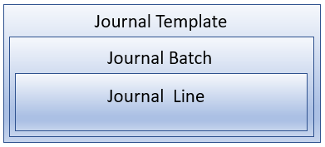
Journal Posting

Slide 53
Journal Posting - Codeunits
Posting Codeunit | Ends with | Example
Check Line | 1 | 11 Gen. Jnl.-Check Line
Post Line | 2 | 12 Gen. Jnl.-Post Line
Post Batch | 3 | 13 Gen. Jnl.-Post Batch

Slide 54
Journal Posting – Starter Codeunits
Codeunit | Description | Object ID ends with | Example
Post | Asks the user whether to post, and then calls Post Batch. | 1 | 231 Gen. Jnl.-Post
Post + Print | Asks the user whether to post, then calls Post Batch, and then calls the Register Report. | 2 | 232 Gen. Jnl.- Post+Print
Batch Post | Asks whether to post the selected batches and then repeatedly calls Post Batch for each selected batch. Users can run this codeunit only from the Journal Batches page. | 3 | 233 Gen. Jnl.-B.Post
Batch Post + Print | Confirms that the user wants to post the selected batches, then calls Post Batch for each selected batch, and then calls the Register Report. | 4 | 234 Gen. Jnl.-B. Post+Print

Slide 55
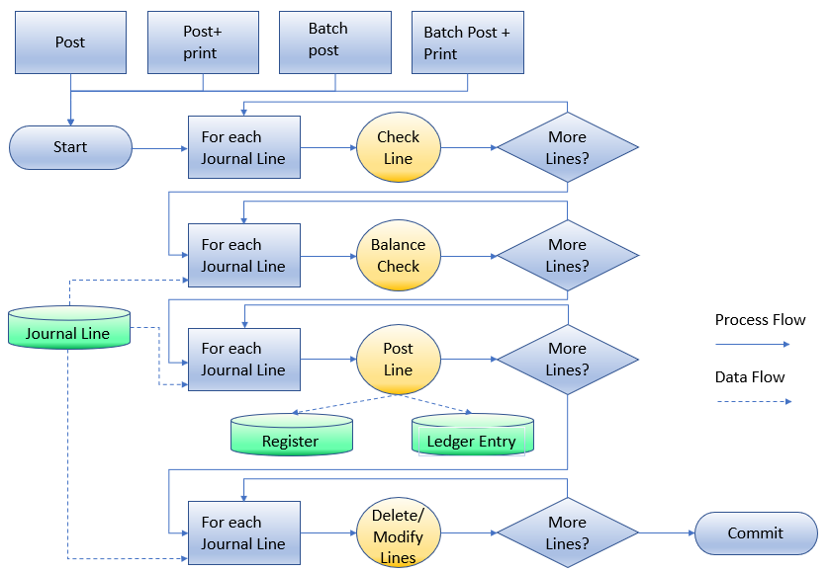
The Journal Posting Process

Slide 56
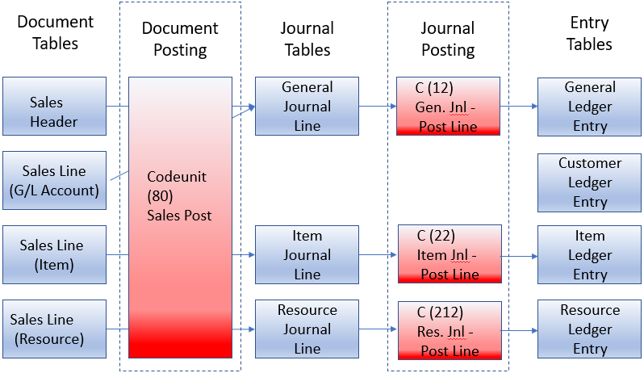
Document Posting Routines

Slide 57
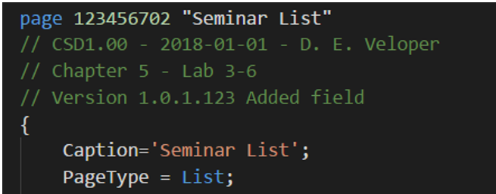
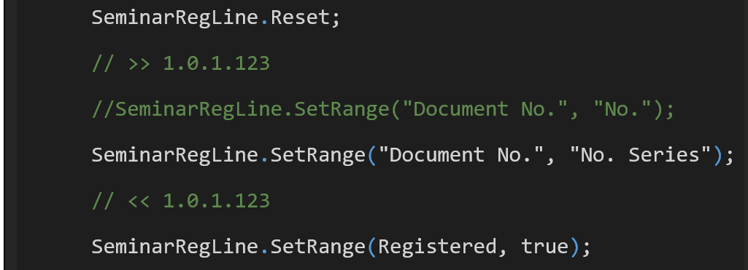
Code Comments
Documentation
Inline Comments

Slide 58
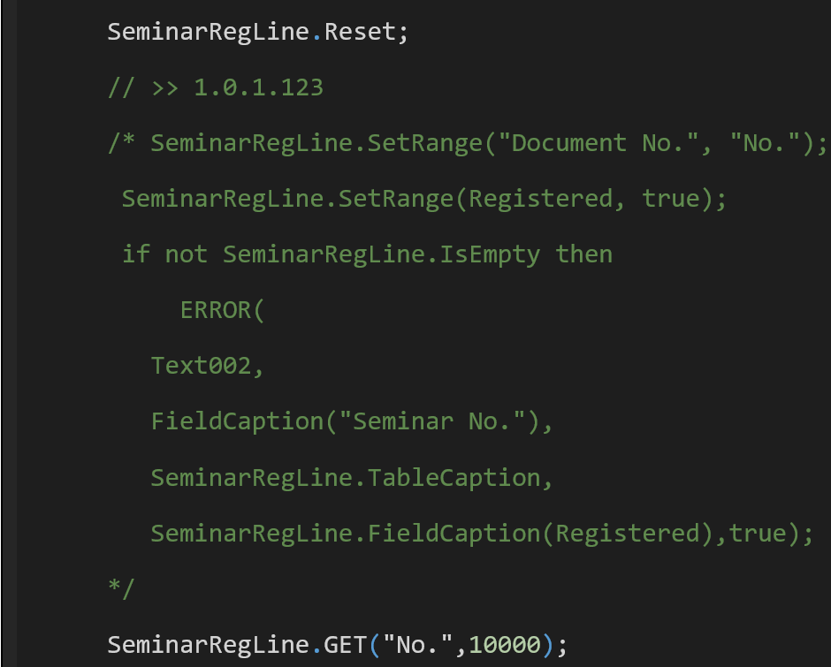
Code Comments
Block comments

Slide 59
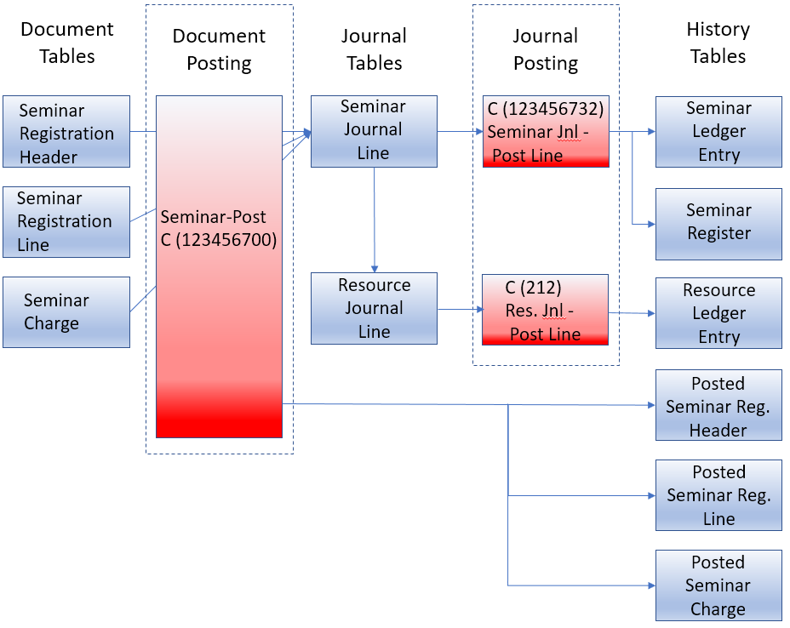
Seminar Document Posting Routines

Slide 60
Changing Tables that Contain Data
Changes to Fields
You can always make the following changes to table fields:
Change the name is possible in the Development Environment, but it is no possible in extensions made in VS Code.
Change any properties that only control how data is displayed or formatted.
Change the TableRelation and ValidateTableRelation properties.
Change a FlowField back to a regular field.
Change the CalcFormula on a FlowField.
Increase the length of a text or a code field.
Add a new field.

Slide 61
Changing Tables that Contain Data
Changes to Fields
If one of the following changes is made to the table structure after it has been installed once, it is not possible to send the extension to Dynamics 365 BC:
Change the Data Type.
Change the Field No.
Change the Field Name
Change a normal field into a FlowField.
Disable a field by setting Enabled to No.
Delete the field.
"schemaUpdateMode": "Recreate"
In the launch.json file.

Slide 62
Escrow services
Source code escrow is the deposit of the source code of software with a third-party escrow agent. It ensures maintenance of the software if the solution licensor files for bankruptcy or otherwise fails to maintain and update the software as promised in the software license agreement. As Microsoft states, this requirement is aimed to protect the investment of the customer now and in the future.
The Software Escrow requirement is mandatory for CfMD approval if the solution is not offered free of charge and not sold by subscription

Slide 63
Seminar Feature Integration
Category | Features
Trail Record | Enables the Navigate feature to search for new ledger entry and posted document types.
Master Pages | Create new documents from master pages. Access open documents from master pages. Access ledger entries from master pages.
Transactions | Access Navigate from posted document pages. Access Navigate from ledger entries.

Slide 64
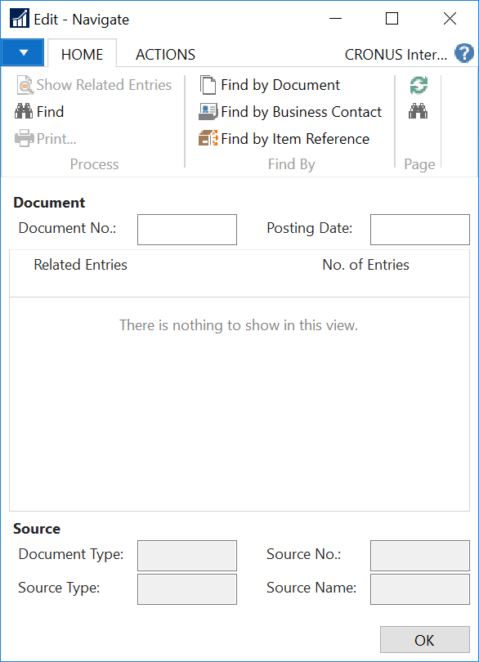
Navigate Page

Slide 65
Navigate functions
Functions
Integration Events
FindPush
FindRecords and FindExtRecords
InsertIntoDocEntry
ShowRecords
= OnAfterNavigateFindRecords
= OnAfterNavigateShowRecords
OnAfterNavigateFindTrackingRecords

Slide 66

Lab overview
Lab 1 Discussion
Lab 2-1 Normal
Lab 3-1 Normal
Lab 4-1 Normal
Lab 5-1 Normal
Lab 5-2 Normal
Lab 5-3 Normal
Lab 6-1 Review
Lab 6-2 Review
Lab 6-3 Normal
Lab 7-1 Review
Lab 7-2 Solution and Review
Lab 7-3 Solution and Review
Lab 7-4 Solution and Review
Lab 7-5 Solution and Review
Lab 8-1 Solution and Review
Lab 8-2 Solution and Review
Lab 9-1 Normal
Lab 9-2 Solution and Review
Lab 10-1 Normal

